Slide 1
NEWS NOW APP

Slide 2
DESCRIPTION
A news reading app is a tool designed to help users stay updated with the latest news and information from various sources, such as newspapers, blogs, and media outlets. It serves as a convenient platform for accessing news articles, breaking stories, and in-depth analyses, providing real-time updates to users on their mobile devices.
News Feed:he central feature of any news app, the news feed displays a constant stream of articles, headlines, and updates from various categories such as politics, entertainment, sports, and technology. This feed can be customized to show content based on user preferences and location, ensuring the user gets relevant information.
Article Archive: Many news apps offer a searchable archive where users can browse past articles. These archives often include stories that have already been published and allow users to catch up on important news they may have missed.
Push Notifications: News apps often use push notifications to alert users about breaking news or important updates. This feature ensures that users are immediately notified when a major event occurs, even when they are not actively using the app.
Personalization:Advanced news apps offer personalized content, recommending articles based on the user’s reading history, preferences, and interests. Users can also select topics or news sources they want to follow, ensuring that the app delivers only the most relevant stories.

Slide 3
Main Activity.kts:
package np.com.bimalkafle.newsnow
import android.os.Bundle
import androidx.activity.ComponentActivity
import androidx.activity.compose.setContent
import androidx.activity.enableEdgeToEdge
import androidx.compose.foundation.layout.Column
import androidx.compose.foundation.layout.fillMaxSize
import androidx.compose.foundation.layout.padding
import androidx.compose.material3.Scaffold
import androidx.compose.material3.Text
import androidx.compose.ui.Alignment
import androidx.compose.ui.Modifier
import androidx.compose.ui.graphics.Color
import androidx.compose.ui.text.font.FontFamily
import androidx.compose.ui.unit.sp
import androidx.lifecycle.ViewModelProvider
import androidx.navigation.compose.NavHost
import androidx.navigation.compose.composable
import androidx.navigation.compose.rememberNavController
import androidx.navigation.toRoute
import np.com.bimalkafle.newsnow.ui.theme.NewsNowTheme

Slide 4
class MainActivity : ComponentActivity() {
override fun onCreate(savedInstanceState: Bundle?) {
super.onCreate(savedInstanceState)
enableEdgeToEdge()
val newsViewModel = ViewModelProvider(this)[NewsViewModel::class.java]
setContent {
val navController = rememberNavController()
NewsNowTheme {
Scaffold(modifier = Modifier.fillMaxSize()) { innerPadding ->
Column(
modifier = Modifier
.padding(innerPadding)
.fillMaxSize()
) {
Text(
text = "NEWS NOW",
modifier = Modifier.align(Alignment.CenterHorizontally),
color = Color.Red,
fontSize = 25.sp,
fontFamily = FontFamily.Serif
)

Slide 5
public void onClick(View v) {
runs = runs+2;
run.setText(Integer.toString(runs));
balls = balls+1;
over.setText(Integer.toString(balls));
}
});
three.setOnClickListener(new View.OnClickListener() {
@Override
public void onClick(View v) {
runs = runs+3;
run.setText(Integer.toString(runs));
balls = balls+1;
over.setText(Integer.toString(balls));
}
});
four.setOnClickListener(new View.OnClickListener() {
@Override
public void onClick(View v) {
runs = runs+4;
run.setText(Integer.toString(runs));
balls = balls+1;
over.setText(Integer.toString(balls));
}

Slide 6
Text(
text = "NEWS NOW",
modifier = Modifier.align(Alignment.CenterHorizontally),
color = Color.Red,
fontSize = 25.sp,
fontFamily = FontFamily.Serif
)
NavHost(navController = navController, startDestination = HomePageScreen) {
composable<HomePageScreen> {
HomePage(newsViewModel,navController)
}
composable<NewsArticleScreen> {
val args = it.toRoute<NewsArticleScreen>()
NewsArticlePage(args.url)
}
}
}
}
}

Slide 7
Homepage.kts:
package np.com.bimalkafle.newsnow
import androidx.compose.foundation.border
import androidx.compose.foundation.horizontalScroll
import androidx.compose.foundation.layout.Column
import androidx.compose.foundation.layout.Row
import androidx.compose.foundation.layout.aspectRatio
import androidx.compose.foundation.layout.fillMaxSize
import androidx.compose.foundation.layout.fillMaxWidth
import androidx.compose.foundation.layout.height
import androidx.compose.foundation.layout.padding
import androidx.compose.foundation.layout.size
import androidx.compose.foundation.lazy.LazyColumn
import androidx.compose.foundation.lazy.items
import androidx.compose.foundation.rememberScrollState
import androidx.compose.foundation.shape.CircleShape
import androidx.compose.material.icons.Icons
import androidx.compose.material.icons.filled.Search
import androidx.compose.material3.Button
import androidx.compose.material3.Card
import androidx.compose.material3.CardDefaults
import androidx.compose.material3.Ico

Slide 8
package np.com.bimalkafle.newsnow.ui.theme
import androidx.compose.material3.Typography
import androidx.compose.ui.text.TextStyle
import androidx.compose.ui.text.font.FontFamily
import androidx.compose.ui.text.font.FontWeight
import androidx.compose.ui.unit.sp
// Set of Material typography styles to start with
val Typography = Typography(
bodyLarge = TextStyle(
fontFamily = FontFamily.Default,
fontWeight = FontWeight.Normal,
fontSize = 16.sp,
lineHeight = 24.sp,
letterSpacing = 0.5.sp
)
fontWeight = FontWeight.Normal,
fontSize = 22.sp,
lineHeight = 28.sp,
letterSpacing = 0.sp

Slide 9
public void onClick(View v) {
String no = exruns.getText().toString();
int zero =0;
int a = Integer.parseInt(no);
runs = runs+a;
run.setText(Integer.toString(runs));
exruns.setText(Integer.toString(zero));
}
});
}
}
Activity_main.xml:
@Composable
fun NewsArticlePage(url: String) {
AndroidView(factory = { context ->
WebView(context).apply {
settings.javaScriptEnabled = true
webViewClient = WebViewClient()
loadUrl(url)
}
})
}

Slide 10
class NewsViewModel : ViewModel() {
private val _articles = MutableLiveData<List<Article>>()
val articles: LiveData<List<Article>> = _articles
init {
fetchNewsTopHeadlines()
}
fun fetchNewsTopHeadlines(category : String = "GENERAL"){
val newsApiClient = NewsApiClient(Constant.apiKey) )
val request = TopHeadlinesRequest.Builder().language("en").category(category).build()
newsApiClient.getTopHeadlines(request, object : NewsApiClient.ArticlesResponseCallback{
override fun onSuccess(response: ArticleResponse?) {
response?.articles?.let
}

Slide 11
fun fetchEverythingWithQuery(query : String){
val newsApiClient = NewsApiClient(Constant.apiKey)
val request = EverythingRequest.Builder().language("en").q(query).build()
newsApiClient.getEverything(request, object : NewsApiClient.ArticlesResponseCallback{
override fun onSuccess(response: ArticleResponse?) {
response?.articles?.let {
_articles.postValue(it)
}
}
override fun onFailure(throwable: Throwable?) {
if (throwable != null) {
Log.i("NewsAPI Response Failed",throwable.localizedMessage)
}
}
})
}
}

Slide 12
@Serializable
object HomePageScreen
@Serializable
data class NewsArticleScreen(
val url : String
)
<?xml version="1.0" encoding="utf-8"?>
<manifest xmlns:android="http://schemas.android.com/apk/res/android"
xmlns:tools="http://schemas.android.com/tools">
<uses-permission android:name="android.permission.INTERNET"/>
<application
android:allowBackup="true"
android:dataExtractionRules="@xml/data_extraction_rules"
android:fullBackupContent="@xml/backup_rules"
android:icon="@mipmap/ic_launcher"
android:label="@string/app_name"
android:roundIcon="@mipmap/ic_launcher_round"

Slide 13
android {
namespace = "np.com.bimalkafle.newsnow"
compileSdk = 34
defaultConfig {
applicationId = "np.com.bimalkafle.newsnow"
minSdk = 26
targetSdk = 34
versionCode = 1
versionName = "1.0"
testInstrumentationRunner = "androidx.test.runner.AndroidJUnitRunner"
vectorDrawables {
useSupportLibrary = true
}
}
buildTypes {
release {
isMinifyEnabled = false
proguardFiles(
getDefaultProguardFile("proguard-android-optimize.txt"),

Slide 14
compileOptions {
sourceCompatibility = JavaVersion.VERSION_1_8
targetCompatibility = JavaVersion.VERSION_1_8
}
kotlinOptions {
jvmTarget = "1.8"
}
buildFeatures {
compose = true
}
composeOptions {
kotlinCompilerExtensionVersion = "1.5.1"
}
packaging {
resources {
excludes += "/META-INF/{AL2.0,LGPL2.1}"
}
}
}
dependencies {
implementation(libs.androidx.core.ktx)
implementation(libs.androidx.lifecycle.runtime.ktx)

Slide 15
@RunWith(AndroidJUnit4::class)
class ExampleInstrumentedTest {
@Test
fun useAppContext() {
// Context of the app under test.
val appContext = InstrumentationRegistry.getInstrumentation().targetContext
assertEquals("np.com.bimalkafle.newsnow", appContext.packageName)
}
}
class ExampleUnitTest {
@Test
fun addition_isCorrect() {
assertEquals(4, 2 + 2)
}
}
class ExampleUnitTest {
@Test
fun addition_isCorrect() {
assertEquals(4, 2 + 2)
}
}

Slide 16
plugins {
alias(libs.plugins.android.application) apply false
alias(libs.plugins.jetbrains.kotlin.android) apply false
}
plluginManagement {
repositories {
google {
content {
includeGroupByRegex("com\\.android.*")
includeGroupByRegex("com\\.google.*")
includeGroupByRegex("androidx.*")
}
}
mavenCentral()
gradlePluginPortal()
}
}
dependencyResolutionManagement {
repositoriesMode.set(RepositoriesMode.FAIL_ON_PROJECT_REPOS)
repositories {
google()
mavenCentral()
maven ("https://jitpack.io")
}
}

Slide 17
HTML:
<!DOCTYPE html>
<html lang="en">
<head>
<meta charset="UTF-8">
<meta name="viewport" content="width=device-width, initial-scale=1.0">
<title>Tech Conference 2024</title>
<link rel="stylesheet" href="indrx.css">
</head>
<body>
<header>
<h1>Tech Conference 2024</h1>
<nav>
<ul>
<li><a href="#home">Home</a></li>
<li><a href="#schedule">Schedule</a></li>
<li><a href="#speakers">Speakers</a></li>
<li><a href="#register">Register</a></li>
</ul>
</nav>
</header>

Slide 18
<section id="home">
<h2>Welcome to Tech Conference 2024</h2>
<p>Join us for a day of insightful talks and networking with industry leaders.</p>
</section>
<section id="schedule">
<h2>Schedule</h2>
<ul>
<li>09:00 AM - Opening Keynote</li>
<li>10:00 AM - Session 1: The Future of AI</li>
<li>11:00 AM - Break</li>
<li>11:30 AM - Session 2: Cybersecurity Trends</li>
<li>12:30 PM - Lunch</li>
<li>02:00 PM - Session 3: Innovations in Blockchain</li>
<li>03:00 PM - Closing Remarks</li>
</ul>
</section>
<section id="speakers">
<h2>Speakers</h2>
<ul>
<li>Dr. Jane Smith - Expert in AI and Machine Learning</li>
<li>John Doe - Cybersecurity Specialist</li>
<li>Mary Johnson - Blockchain Innovator</li>

Slide 19
</ul>
</section>
<section id="register">
<h2>Register</h2>
<form>
<label for="name">Name:</label>
<input type="text" id="name" name="name" required>
<br>
<label for="email">Email:</label>
<input type="email" id="email" name="email" required>
<br>
<input type="submit" value="Register">
</form>
</section>
<br>
<br><br>
<footer>
<p>&copy; 2024 Tech Conference. All rights reserved.</p>
</footer>
</body>
</html>

Slide 20

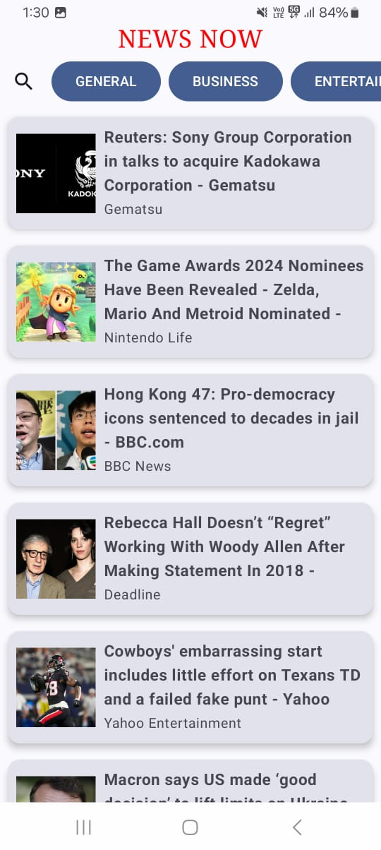
OUTPUT:

Slide 21
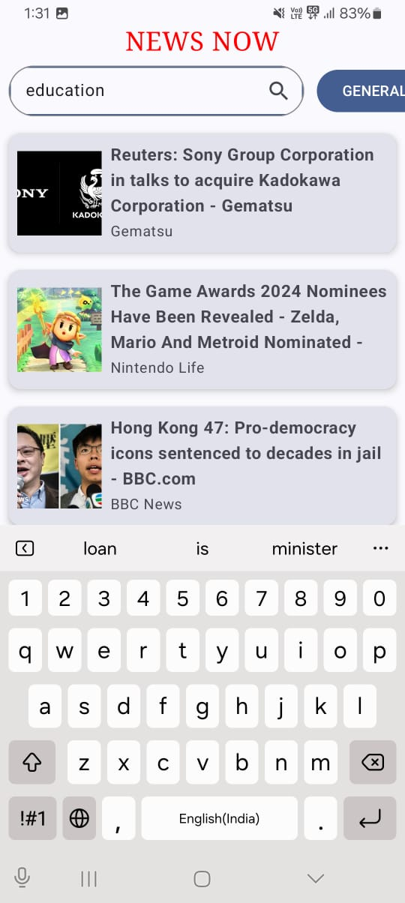
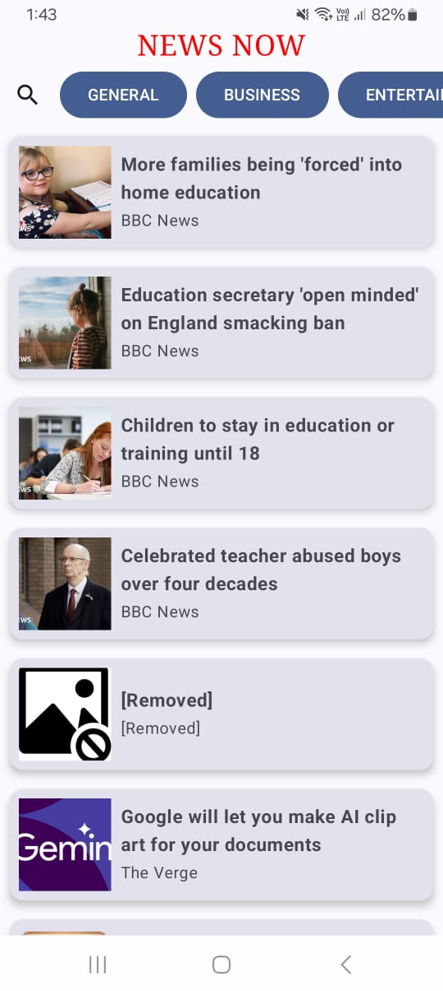

Slide 22
